Slide 1
The Rule of 72

Slide 2
Course Flow Chart
Goals & Vision
Career Choice & Research
College & Certificates
Resume & Job Interviews
Choosing an Offer
Paycheck & Taxes
Budget & Retirement Planning
Savings & Investing
Credit Cards & Debt/Bankruptcy
Scams & Identity Theft
Auto/Housing Insurance & Loans

Slide 3
Investing for Retirement
Toy Story 3 – Toy Retirement

Slide 4
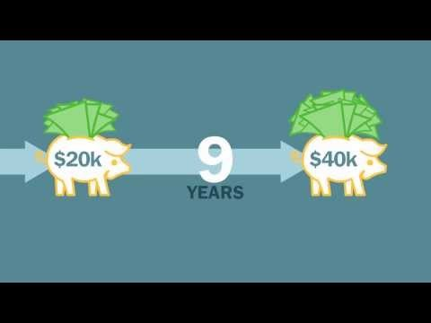
Rule of 72
The most important and simple rule to financial success.
The answers can be easily discovered by knowing the Rule of 72
The time it will take an investment (or debt) to double in value at a given interest rate using compounding interest.
72 | = | Years to
Interest Rate |  | double investment (or debt)

Slide 5
Albert Einstein
Credited for discovering the mathematical equation for compounding interest, thus the “Rule of 72”
T=P(I+I/N)^{YN}
“It is the greatest mathematical discovery of all time.”
Notes:
P = original principal amount
I = annual interest rate (in decimal form)
N = number of compounding periods per year
Y = number of years
T = total of principal and interest to date (after n compounding periods)

Slide 6
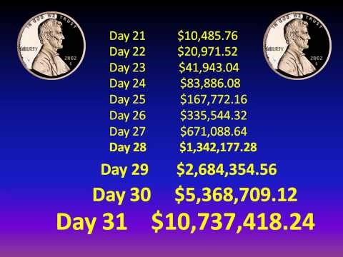
What the “Rule of 72” can determine
How many years it will take an investment to double at a given interest rate using compounding interest.
How long it will take debt to double if no payments are made.
The interest rate an investment must earn to double within a specific time period.
How many times money (or debt) will double in a specific time period.

Slide 7
Things to Know about the “Rule of 72”
The “Rule of 72”
Is only an approximation
The interest rate must remain constant
The equation does not allow for additional payments to be made to the original amount
Interest earned is reinvested
Tax deductions are not included within the equation

Slide 8
Doug’s Certificate of Deposit
According to the rule of 72, if you earn 11% interest on a $5,000 investment, how long will it take you to double your money?
Invested $5,000
Interest Rate is 11%
72 | = | 6.5 years to double investment
11%

Slide 9
Another Example
The average stock market return
since 1926 has been 11%
Therefore, every 6.5 years an individual’s investment in the stock market has doubled
72 | = | 6.5 years to double investment
11%

Slide 10
Jessica’s Credit Card Debt
Jessica has a $2,200 balance on her credit card with an 18% interest rate. If Jessica chooses to not make any payments and does not receive late charges, how long will it take for her balance to double?
$2,200 balance on credit card
18% interest rate
72 | = | 4 years to double debt
18%
Notes:
This equation assumes that no additional payments or late fees were charged
Generally minimum payments on credit cards are 2% of the account balance each month

Slide 11
Another Example
$6,000 balance on credit card
22% interest rate
72 | = | 3.3 years to double debt
22%

Slide 12
Jacob’s Car
Jacob currently has $5,000 to invest in a car after graduation in 4 years. What interest rate is required for him to double his investment?
$5,000 to invest
Wants investment to double in 4 years
72 | = | 18% interest rate
4 years

Slide 13
Another Example
$3,000 to invest
Wants investment to double in 10 years
72 | = | 7.2% interest rate
10 years

Slide 14
Rhonda’s Treasury Note
Rhonda is 22 years old and would like to invest $2,500 into a U.S. Treasury Note earning 7.5% interest. How many times will Rhonda’s investment double before she withdraws it at age 70?
Age | Investment
22 | $2,500
31.6 | $5,000
41.2 | $10,000
50.8 | $20,000
60.4 | $40,000
70 | $80,000
72 | = | 9.6 years
7.5% |  | to double investment

Slide 15
Another Example
$500 invested at age 18
7% interest
How many times will investment double before age 65?
Age | Investment
18 | $500
28.2 | $1,000
38.4 | $2,000
48.6 | $4,000
58.8 | $8,000
69 | $16,000
72 | = | 10.2 years
7% |  | to double investment

Slide 16
Taxes
A person can choose to invest into two types of accounts:
Taxable Account – taxes charged to earned interest
Roth IRA (Individual Retirement Account)
Tax Deferred Account – taxes are not paid until the individual withdraws the money from the investment
IRA
401k
Notes:
A person wants to invest money into a tax deferred account so the interest continues to work for them.

Slide 17
401k and IRA’s
401K (Do this First if Matched)
Maximum of $18,000
Sometimes 401k’s are matched by employers
Employer sponsored tax sheltered retirement plan
Roth IRA (Great for Monthly Ret. Withdrawals)
Money is put in the Roth IRA from Net Pay.
Taxes are paid on the Principle first then added to the fund.
Taxes are paid on the Interest upon withdrawal.
Maximum contribution of $5,500/year ($6,500 if 50+)

Slide 18
401k and IRA’s
IRA (Great for Large Ret. Purchases)
Money is put in the IRA from the Gross Pay.
Taxes are paid on the Principle AND the Earned Interest upon withdrawal.
Maximum contribution of $5,500/year ($6,500 if 50+)
401K (Last if not Matched)

Slide 19
Taxes Example
George is in the 33% tax bracket. He would like to invest $100,000. George is comparing two accounts that have a 6% interest rate. The first is a taxable account charging interest earned. The second account is tax deferred until he withdraws the money. Which account should George invest his money into?

Slide 20
Effects of taxes
Tax Deferred Account
72 | = | 12 years
6% |  | to double investment
Taxable Account Earning 4% after taxes
72 | = | 18 years
4% |  | to double investment
Years | Taxable | Tax Deferred
12 |  | $200,000
18 | $200,000
24 |  | $400,000
36 | $400,000 | $800,000
Notes:
At 6% interest the money will double every 12 years
At 4% interest the money will double every 18 years

Slide 21
Inflation
Inflation:
The steady rise in the general level of prices.
Products tend to be more expensive now than in the past
Typically is 3% a year.
Diminishes future buying power of saved/invested money.
“A Million Dollars isn’t What it Use to Be!”
Rates of return must be greater than inflation or you are “losing” purchasing power.

Slide 22
Conclusion
The Rule of 72 can tell a person:
How many years it will take an investment to double at a given interest rate using compounding interest;
How long it will take debt to double if no payments are made;
The interest rate an investment must earn to double within a specific time period;
How many times money (or debt) will double in a specific time period.

Slide 23
Conclusion continued
Things individuals must remember about the Rule of 72 include:
Is only an approximation
The interest rate must remain constant
The equation does not allow for additional payments to be made to the original amount
Interest earned is reinvested
Tax deductions are not included within the equation

